Slide 1
How do we manage behaviour at Freeland School?

Slide 2
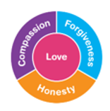
Rewards
At Freeland Primary School we give first attention to best conduct. This affirms the expectations we have for behaviour and encourages children to aspire to them. Children will be rewarded for good behaviour by:
4R’s celebration- this takes place in assembly on Thursdays. Teachers nominate pupils who have shown that they have used any of the 4R’s during the previous week.
Recognition board- each class from Y1-6 has a recognition board and this is used to praise the children who show a particular learning behaviour during the lesson eg working with focus, supporting one another when working in a group, listening to each other, editing their work carefully etc.
Celebration assemblies take place on Thursdays and allow children to celebrate any successes they may have had in and out of school e.g. passing a music exam, a sporting achievement.
Showing work to another teacher or a member of the Senior Leadership Team- if children have shown particular effort with a piece of work, they will be invited to show it to another member of staff to ‘show it off.’
Verbal praise
Sending home good news slips to let parents/carers know when children have gone over and above in their work or behaviour. (see appendix 2)
Headteacher’s awards.
Dojos for great effort and behaviour. (see appendix 3)
Hot Chocolate Friday- rewards those children who always do their best and always show excellent levels of behaviour.

Slide 3
Sanctions
There will be times when behaviour falls below our expectations. In these situations, the member of staff who first noticed/dealt with the behaviour will ensure they see it through to a conclusion, imposing sanctions and supporting the child to restore relationships with those they have affected. If the behaviour is level 4 or 5, a member of SLT will be informed and if needed, support the adult who is dealing with the incident.

Slide 4
Poor behaviour will be dealt with using the following system to encourage the child to improve their behaviour:
First warning.
Second warning.
Intervene using the given script to tell child what the sanction will be, using agreed response and sanction document.
Level 4 and 5 behaviour must be referred to SLT to support member of staff who is dealing with incident. Both SLT and the member of staff will deal with it together to ensure children see that all staff have consistent expectations for behaviour. Level 4 and 5 behaviour must be recorded on an incident form and where appropriate parents informed and a meeting arranged to discuss a way forward. Time will also be made to discuss where things went wrong and allow the child to make amends with adults and/or other children.

Slide 5
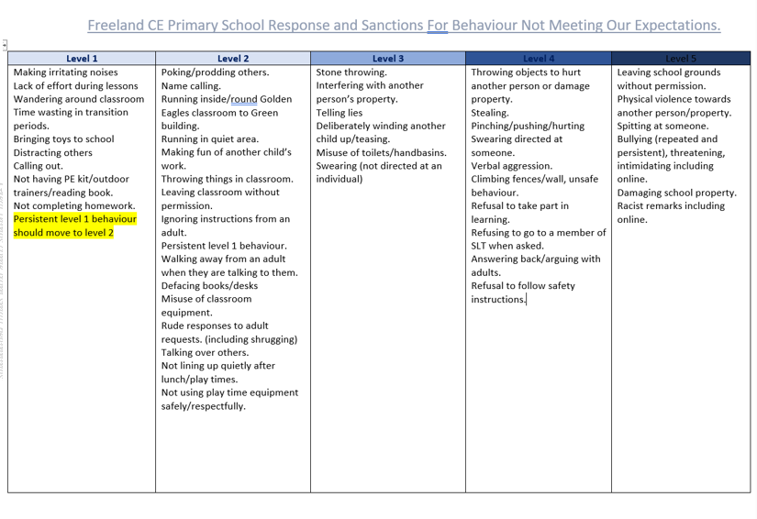

Slide 6
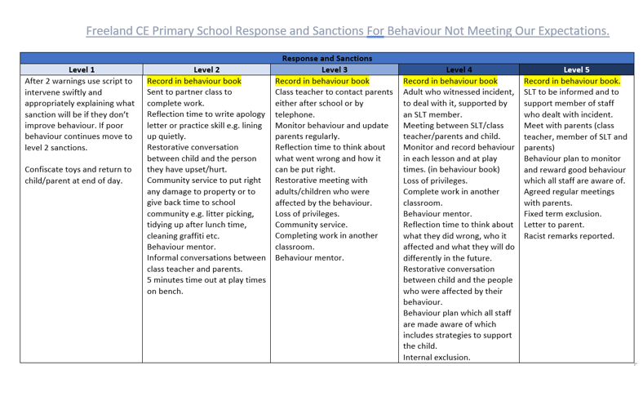

Slide 7
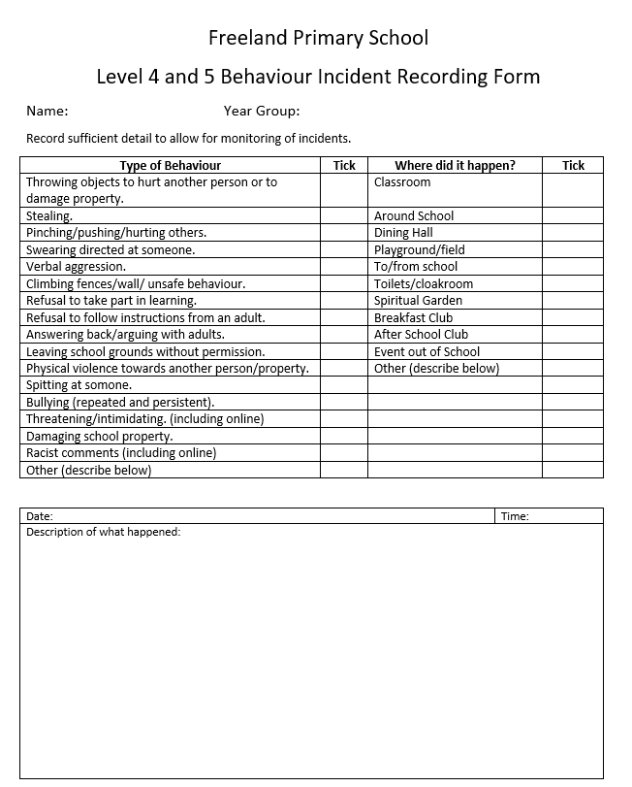
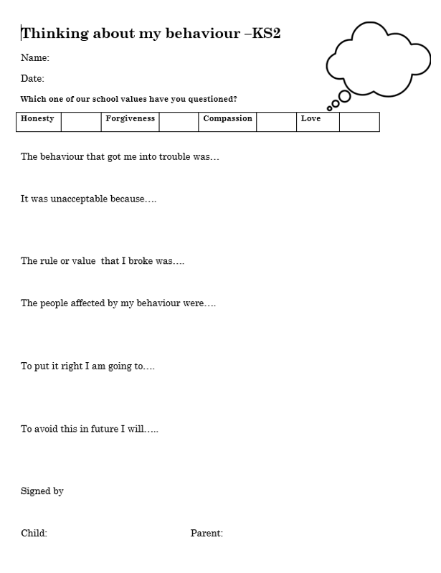

Slide 8
Views on rewards and sanctions

Slide 9
Safeguarding at Freeland Primary School

Slide 10
Safeguarding is our main priority

Slide 11
How do we ensure children are safe at Freeland Primary School?

Slide 12
Behaviour Policy which includes anti bullying procedures.
Practices of procedures in an emergency
ELSA and other interventions to support pupils wellbeing
Attendance monitoring and following up quickly isf a pupil is absent from school.
Staff all trained in safeguarding and PREVENT annually
Teach children how to keep safe-NSPCC assembly and workshops/Bikeability/road safety/E safety
Referrals to CAMHS when needed
Recording concerns effectively and passing on to DSL to follow up
Jigsaw PSHCE scheme taught across all year groups.
Safer recruitment procedures
Health and safety procedures such as risk assessments, fire drills, legionella water testing etc.
All visitors have safeguarding procedures explained to them and must produce a valid DBS if unsupervised.
Child Protection Policy
Staff Code of Conduct Policy
Early Help assessments and Team Around the Family meetings to support families when needed.

Slide 13
Any questions?

